Slide 1
Modelling Multi-dimensional Opinions and Polarization Formation
The Opinioneers
Michael Andres, Florian Dorner, Gian Luca Gehwolf, Fabian Hafner, David Metzger
Complex Social Systems
7 December 2020

Slide 2
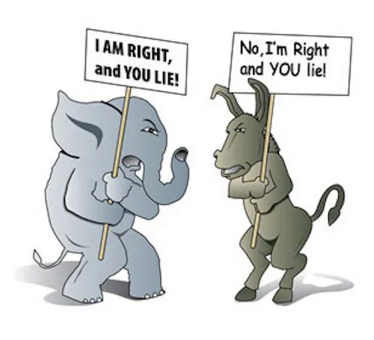
Motivation
Political polarization is a threat to political stability
How can opinion polarization be simulated?
Weighted Balance Theory Model by Schweighofer et al. (2020)
How can opinion polarization dynamics be influenced by...
Network structures
→ Coevolution of networks and opinions model developed by Holme and Newman (2006)
Bots
Source: http://thecontextofthings.com/2014/01/12
Notes:
Notes:
Political polarization in democratic societies has reached a point, where it poses a threat to political stability. The (re-)emergence of populism in certain countries in Europe and in the US has led to divided societies with strongly opposing opinions.
We are interested to study how opinion polarization can be simulated.
We use the Weighted Balance Theory Model developed by Schweighofer et al. (2020) as a starting point, which is a multidimensional opinion dynamics model that can generate opinion polarization without taking the effects of network structures on polarization into account.
We want to study what effect the introduction of networks have on opinion polarization dynamics
For this we combine the WBT model with a coevolution model by proposing a set of extension to the coevolution model which gives us a generalized model that can generate opinion polarization and at the same time takes into account the effects of a mutual and simultaneous influences of network structures and opinions.
Additionally, we want to see what influence the introduction of bots has on this generalized model

Slide 3
How do opinion formation models work?
j
Other agents and graph/network structure
Opinion dimensions
“topics”
Opinions:
Agent based
d1
continuous
Mutual influence rules i.e. how you adjust your opinion and network
Node i
-1 0 1
against for
d2
a
b
c
d
d3
k
discrete options
Notes:
what we are then interested in is: modelling how groups form and opinions and connections evolve.
for that we define mut inf, set rules for each agent

Slide 4
Model 1: coevolution of opinions and networks
Holme et al. 2006
Discrete, 1D opinions
Randomly initialized network
Example: 30 students need to choose where to go for lunch
Notes:
reproduced. holme.
As an example, think of 30 students
they discuss, change preferences where and with whom they want to eat

Slide 5
Model 1: coevolution of opinions and networks
Holme et al. 2006
Discrete, 1D opinions
Randomly initialized network
Convergence when communities have consensus
3
4
Community Size
Notes:
consensus within connected communities
but first lets look at how agents behave

Slide 6
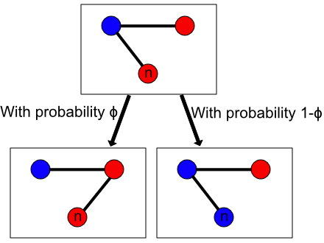
Coevolution Model - influence rules
with probability Φ
connect to like-minded
with probability 1-Φ
adjust my opinion

Slide 7
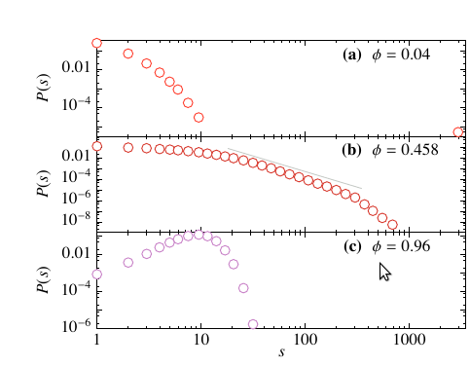
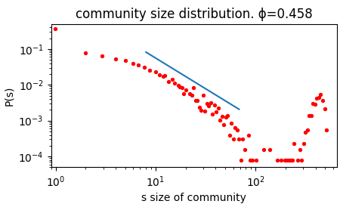
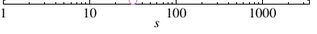
Comparison of Results
Holme 2006
Reproduced by us
Histograms of community sizes (avg)
Notes:
Interesting around 0.5.. have power law distribution, what we find in real social networks like sizes of religious sects. Our simulation lead to some giant components as well, artefact using smaller network because of computational resources.

Slide 8
Model 2: Weighted Balance Theory
Schweighofer et al. 2020
Multidimensional, continuous opinions [-1,+1], no network. Political topics.
How opinions change depends on overall opinion similarness
→ Hyperpolarization: extreme and clustered opinions → Two-party system
Notes:
Central Idea of the paper is that; how you change you opinion when talking to someone depends on how much you agree in general.
central result: they can model hyper
Emergence of socio-political phenomena e.g found in two-party systems

Slide 9
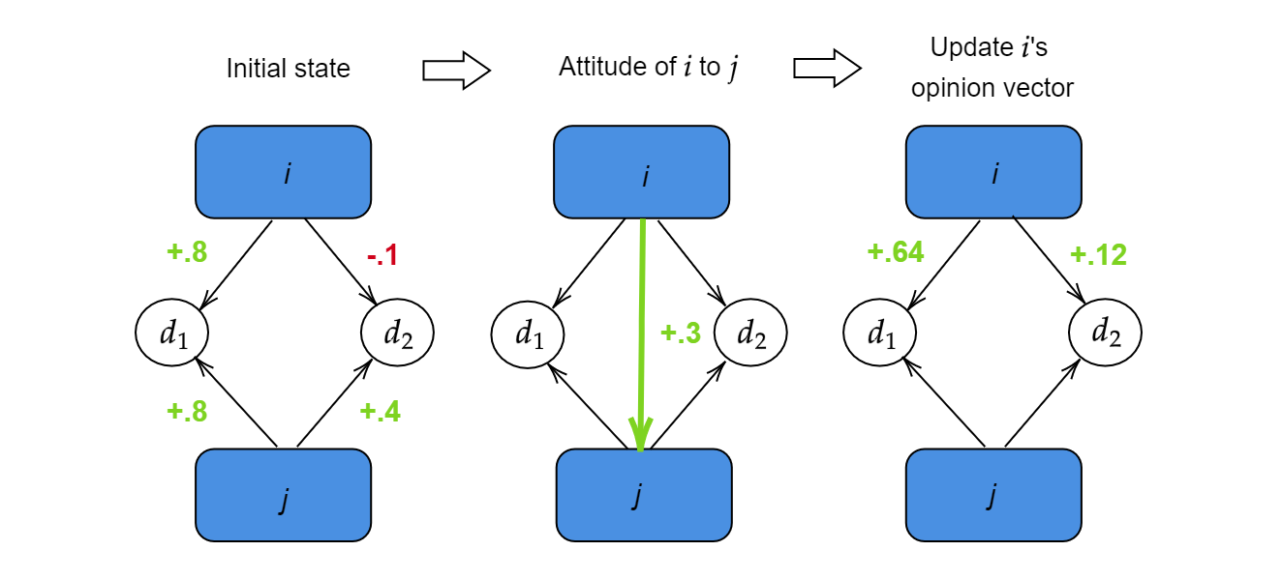
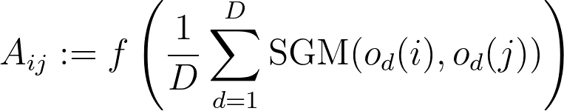
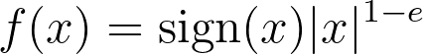
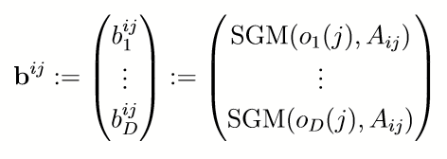
Model 2: Weighted Balance Theory
Interpersonal attitude Aij as measure of closeness
within [-1,+1] based on signed geometric mean and sigmoid evaluative extremeness
Equilibrium / fixed points
Notes:
example where agent i updates its opinion upon interaction with agent j.
opinions
attitude
update (weight) multi/sgm
in each interaction agent i tries to balance its attitude and opinion with J, which means agent i moves its opinon towards one of two equilibrium points:
-if attitude is positive, it moves towards the same opinions as agent j
-if attitude is negative, it moves towards the opposite opinions
can be seen as some kind of backfire effect
Explain polarization vs hyperpolarization
N=500, D=3, e=0.3, alpha=0.4

Slide 10
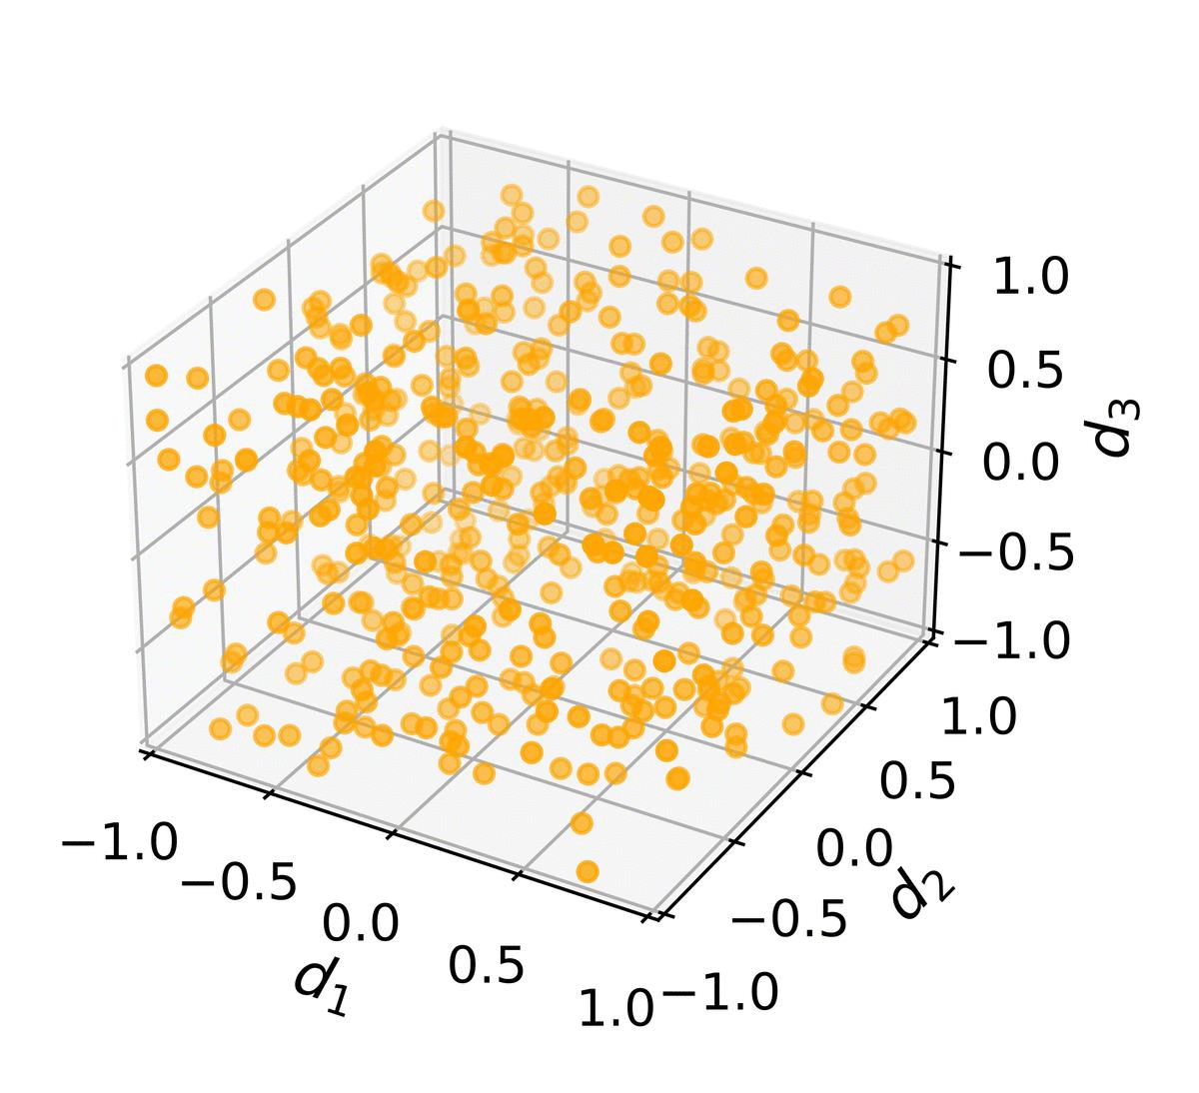
Model 2: Weighted Balance Theory
Hyperpolarisation
Notes:
Explain polarization vs hyperpolarization
N=500, D=3, e=0.3, alpha=0.4

Slide 11
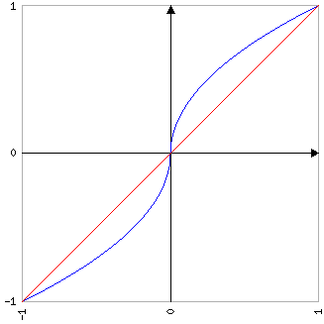
Evaluative extremeness
e = 0.5
attitude
e = 0
opinion closeness
slightly agree on average
slightly disagree on average
like person a lot
dislike a lot
Notes:
explain concept of ‘evaluative extremeness’ → Aij opinion closeness as proxy for how much agents like each other
→ influenced by social field and subject to positive feedbacks
→ authors use weighting function which intensifies good/bad attitudes between agents dependent on parameter e
Justification from …. next slide

Slide 12
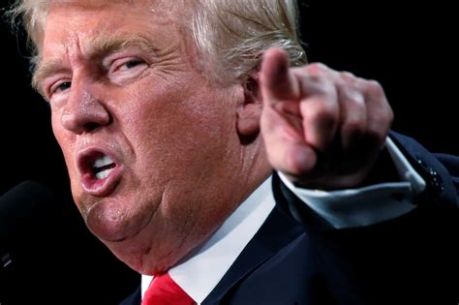
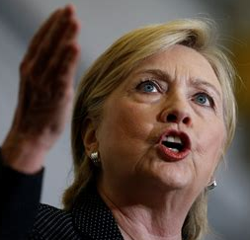
Evaluative extremeness
e = 0.5
attitude
e = 0
opinion closeness
slightly agree on average
slightly disagree on average
like person a lot
dislike a lot
Images: Carlo Allegri / Reuters, Chris Keane / Reuters
Notes:
survey data from US survey( American National Election Study (ANES))
which measured attitude towards democratic/republican candidate
→ opinion about various topics and üerceütionon candidates → perception chanes depending on how similar opinion of respondent and candidate are
→ justification of weighing function

Slide 13
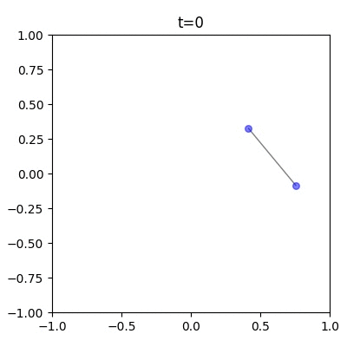
Evaluative extremeness
e > 0 creates drift to corners
→ not entirely unrealistic, but still surprising
Notes:
inherent model behavior → like-minded agent push each other to extremes → no ‘gray area’

Slide 14
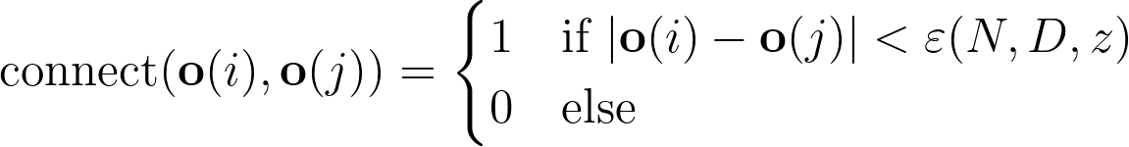
Model 3: Generalized WBT Model
WBT Model implemented into network structure
With probability Φ:
With probability 1-Φ:
→ New behavior: clusters, phase transitions
Notes:
Only one connection per step
Many parameters → further investigate epsilon, phi, take parameters alpha, e, z from before

Slide 15
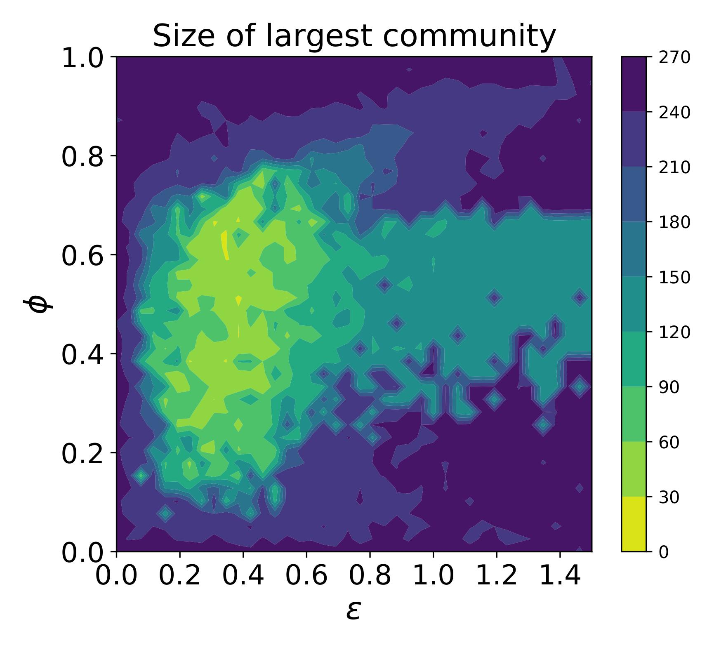
N=250
M=500
D=5
(S)
singular cluster
→ complete alignment
opinion vs edge change
possible hyperpolarization
opinion fragmentation
“influence radius”
Observation: convergence into ~S/N similarly sized clusters
Notes:
Contour plot for N=250, M=500 (avg degree = 2), alpha=0.4, e=0.3, z=0.01, D=5
Observe very different behavior depending on the choice of parameters → we distinguish three phases
→ near complete alignment
→ possible hyperpolarization
→ fragmentation, only singular/small clusters of agents
Observation: convergence into at least S/N similarily sized clusters

Slide 16
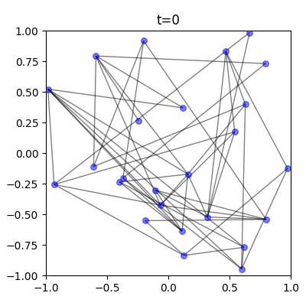
Graph evolution
Opinion about topic 1
from random to polarized
Opinion about topic 2
φ= 0.52,ε= 0.4
Notes:
φ= 0.52,ε= 0.4 and N = 25
we see how graph and opinions evolve.
when the clusters move away, ties are broken because of aforementioned connect function
Here with llow N we again observe polarization

Slide 17
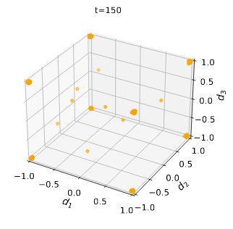
In some cases no hyperpolarization,
just polarization & fragmentation
Clusters in the corners + some disconnected nodes
φ= 0.45,ε= 0.3
Notes:
The model overcomes the limitations odf the WBT model → moreintersting behavior
→ only hyperpolarization in special combinations of parameters
→ often just polarizations into the corners
→ opinions fragment → issue constraint broken

Slide 18

Bots
Like normal nodes but don’t change their opinion
This presentation:
Bots all have same extreme opinion in all dimensions

Slide 19
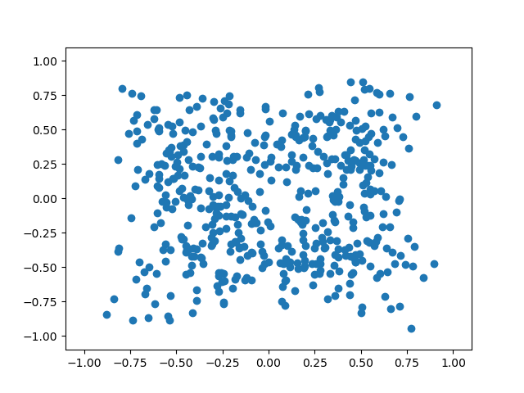
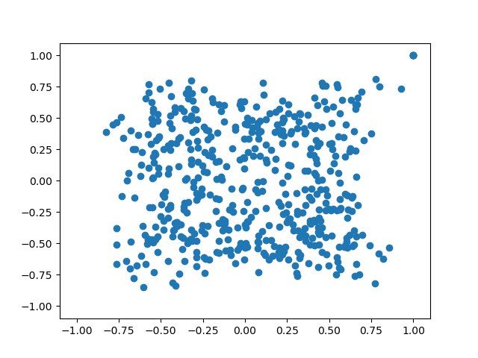
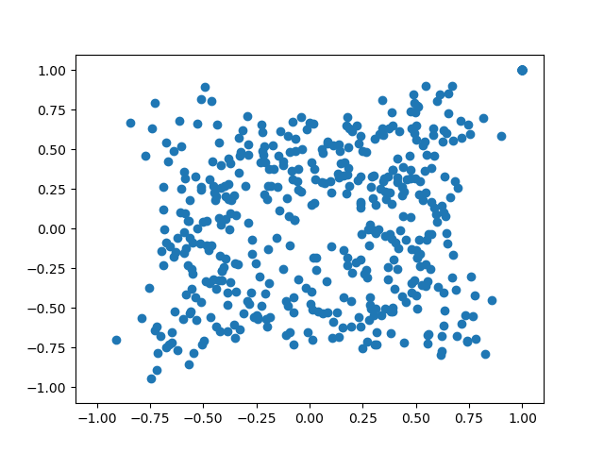
Bots (e=0, fully connected network)
0/500 nodes are bots
5/500 nodes are bots
50/500 nodes are bots
Notes:
Don’t talk about the symmetry!

Slide 20
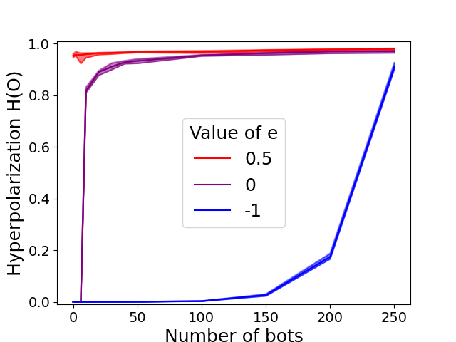
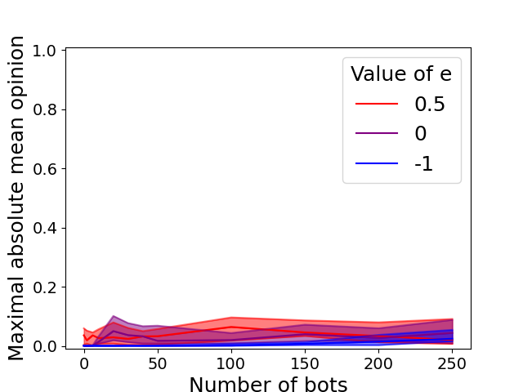
Bots (e=0, fully connected network)
Bots affect polarization
Bots don’t affect the mean opinion
Notes:
e = 0.5 convergence to the edges e=0: convergence to mean e=-1 convergence to middle
H: Think as of generalized variance of opinions normalized to 0,1
Symmetry!
Bots in fact push mean opinion to the middle (start in top right corner!)

Slide 21
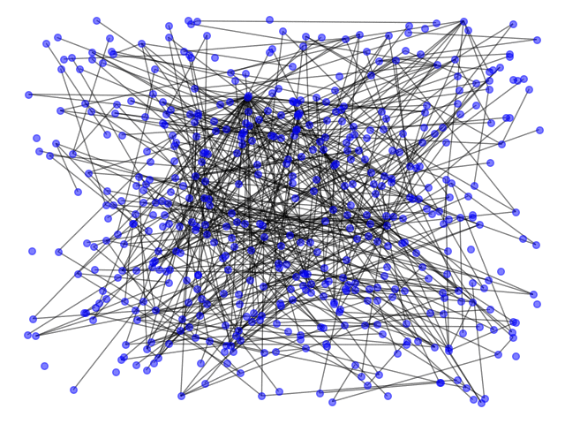
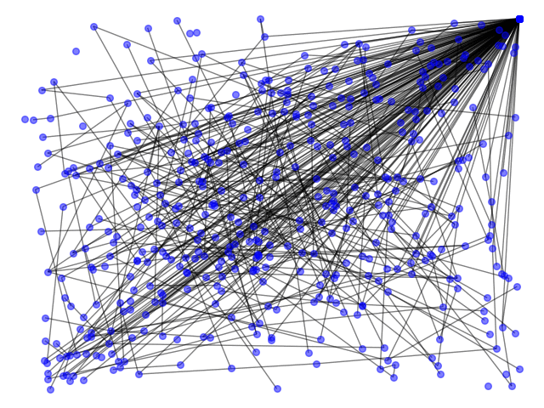
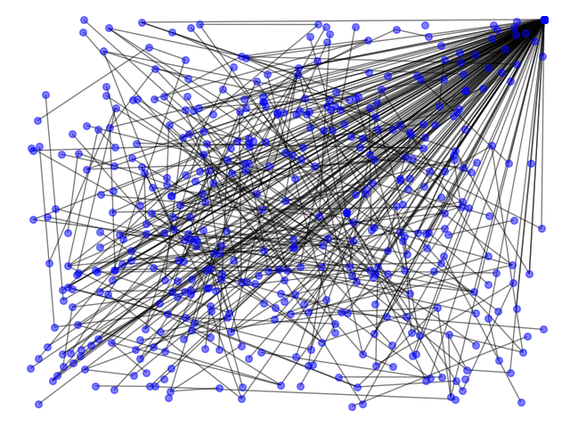
Bots in dynamic BA graph (e=0,ϕ=0.5,ε=1)
No bots
50 bots
50 bots, bots can connect to all
Notes:
Epsilon = Radius of influence
No bots
50 bots
50 bots, bots can connect to everything

Slide 22
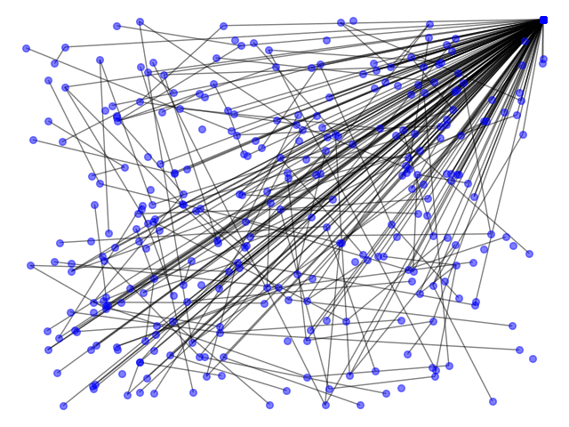
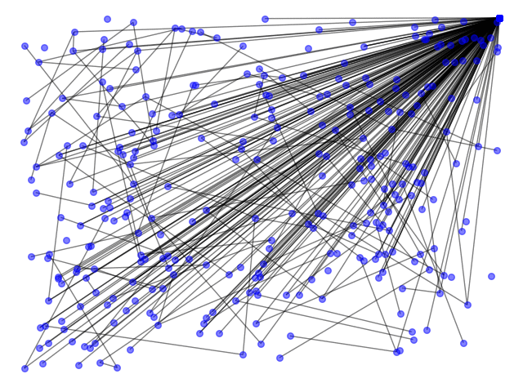
Bots in dynamic BA graph (e=0,ϕ=0.5,ε=1)
200 bots
200 bots, bots can connect to all

Slide 23
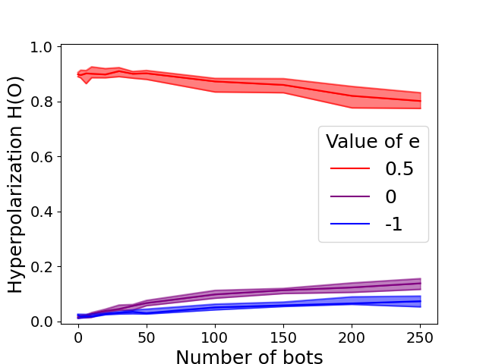
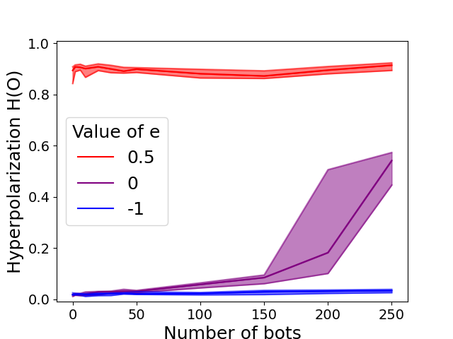
Bots in dynamic BA graph (e=0,ϕ=0.5,ε=1)
Bots connect like all other nodes
Bots can connect to all

Slide 24
Conclusion
Reproduction of Models
Extensions
Critique

Slide 25
Conclusion
Reproduction of Models
very similar findings for reproduced experiments and parameters
only minor deviations due to smaller networks
indicates other results also likely valid for larger networks

Slide 26
Conclusion
variation of parameters
generalization of models
Extensions
effect of bots
changes in network structure
Notes:
generalization -> account for different effects (network based and attitude balancing)
Network structure changes -> fragmentation, shows more realistic effects (non linear)
Varying Parameters -> little change, shows robustness of models / applicability (WBT: d, e, N, z) but also effects eg phi or eps -> fragments, cluster size; when e low, also small number of bots can influence, for hyperpolarization like two party system, for fragments more like interest groups (peta etc)
Influence of bots to polarize / moderate -> largely depends on e

Slide 27
Conclusion
(Hyper)polarization only allows (one) extreme opinion on every topic within one group
Critical assumption on evaluative extremeness
& attitude as function of opinions only
Critique
In general: different models can have very different outcomes
Notes:
Bots: everything concentrates on 2 axis
Get fragments if connection distance is lowered but still extreme opinions
Attitude depends too much on opinions
Different Models for different effects, not for general evolution

Slide 28
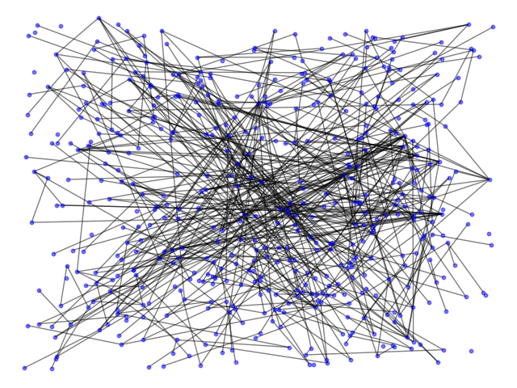
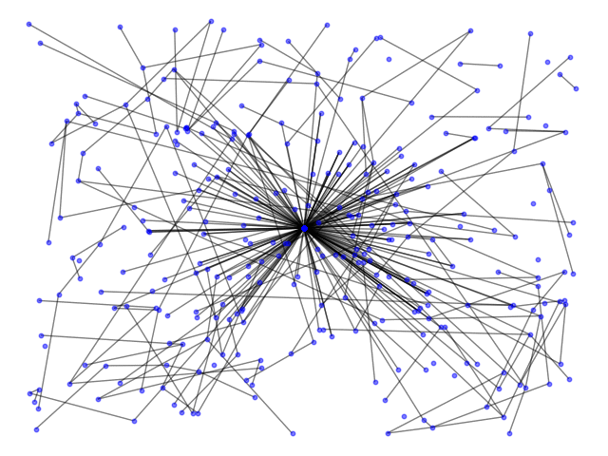
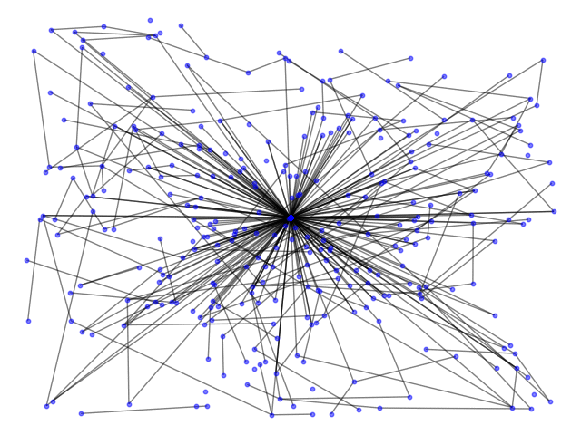
Thank you for your attention
Questions?
Notes:
Hyperpolarization e=0.5
Epsilon= 0.6
No bots
200
200 Seeking

Slide 29
Coevolution Model
connect to like-minded
adjust my opinion
Notes:
with phi the edge jumps to a like-minded node, with prob 1-phi the node adjusts its opinion

Slide 30
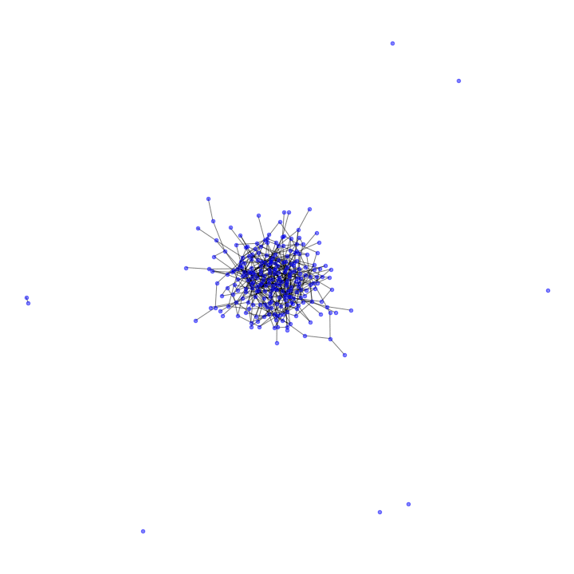

Slide 31
Implementation
Implement our own coevolution model
→ compare it to the coevolution model of Holme and Newman (2006)
Implement our own WBT model
→ compare to WBT model of Schweighofer et al. (2020)
Combine these two models to a generalized model
Notes:
Notes: mention this part in previous slide
How did we proceed to achieve our goals?
1st implement our own coevolution model → compare it to the coevolution model
2nd implement our own WBT model -> validate it as well
3rd combine these two models to the generalized model -> run our

Slide 32
Model 2: Weighted Balance Theory
simultaneous emergence of opinion extremeness and issue constraint (Hyperpolarization)
→ Two-party system, where all opinions are diametrically opposed
Notes:
Emergence of socio-political phenomena e.g found in two-party systems
mean-field approach (fully connected)

Slide 33
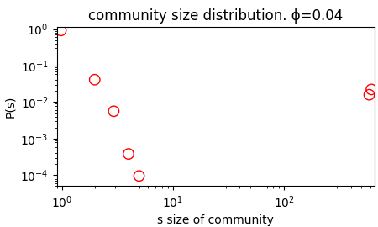
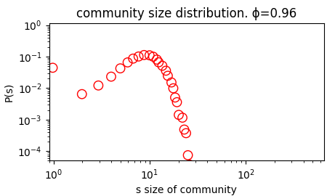
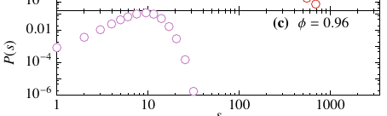
Comparison of Results
Reproduced by us. N=320
Holme 2006
Histograms of community sizes (avg)
Notes:
Extreme cases: 1 only opinion change - one giant component, many small components. 2 only edge change - components of equal opinions, opinions randomly distributed

Slide 34
Reproduced by us
Holme 2006
Random graph with giant component (almost entire graph connected)
Notes:
Extreme cases: 1 only opinion change - one giant component, many small components. 2 only edge change - components of equal opinions, opinions randomly distributed

Slide 35
Reproduced by us
Holme 2006
Random graph with giant component
random assignment on K colors to N slots
Notes:
Extreme cases: 1 only opinion change - one giant component, many small components. 2 only edge change - components of equal opinions, opinions randomly distributed

Slide 36
Model 2: Weighted Balance Theory
simultaneous emergence of opinion extremeness and issue constraint (Hyperpolarization)
→ Two-party system
Multi-dimensional opinion vectors with values within [-1,+1]
Interpersonal attitudes within [-1,+1] weighted with sigmoid-function and parameter e
→ evaluative extremeness (Backfire-Effect, convergence of like-minded agents)
Notes:
Emergence of socio-political phenomena e.g found in two-party systems
mean-field approach (fully connected)

Slide 37
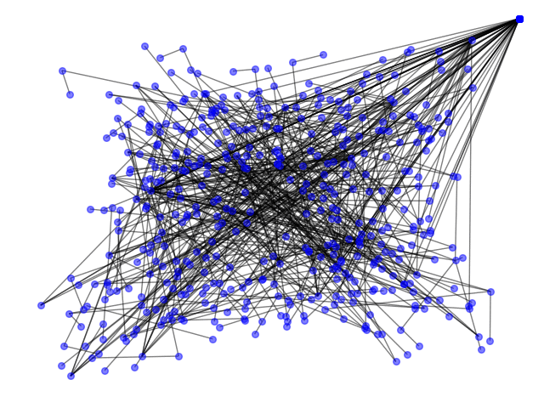
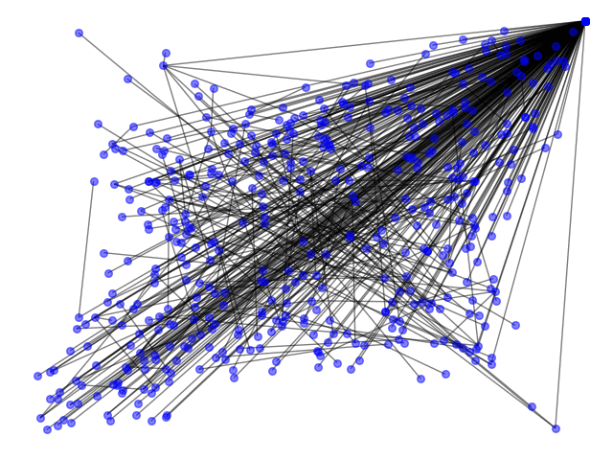
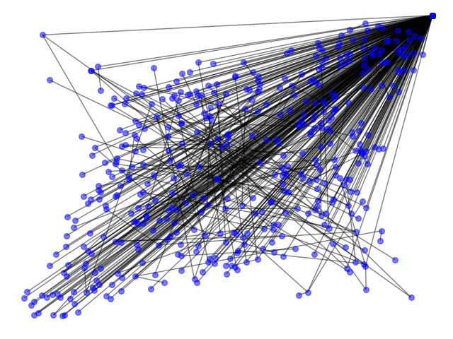
Bots in static Barabási–Albert graph (e=0)
50 bots in least connected nodes
50 bots in random nodes
50 bots in most connected nodes
Notes:
(pronounced Barabaschi)
Power law.
Bots not too connected: variation around second axis, less extreme polarization around main axis.

Slide 38
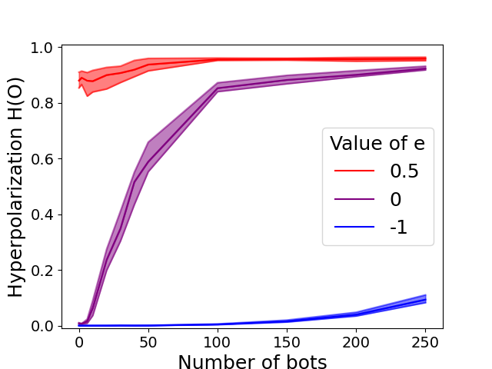
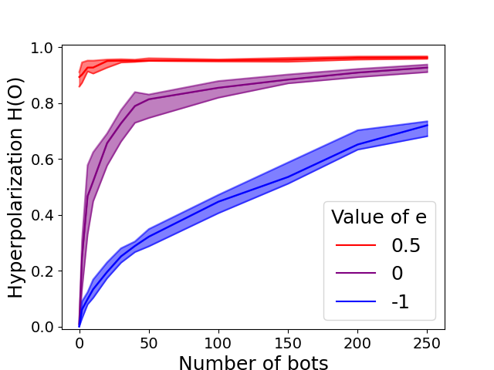
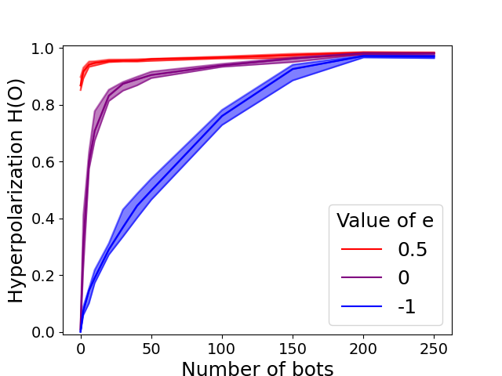
Bots in static Barabási–Albert graph (e=0)
bots in least connected nodes
bots in random nodes
bots in most connected nodes

Slide 39
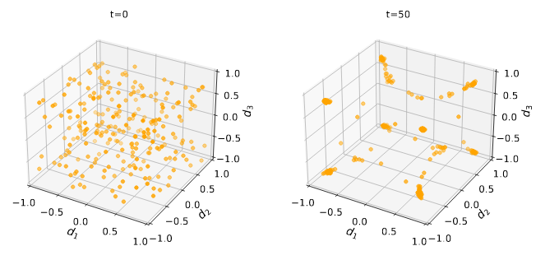
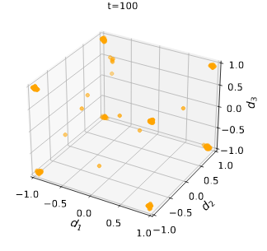
General Model,N= 250,D= 3,e= 0.3,α= 0.3,φ= 0.45,ε(N,D,z) = 0.3.

